Slide 1




Data-Limited Methods Toolkit
Evaluating management strategies for data-limited fish species
Modifying operating models
Lecture 2c, Nov 1st 2017
Tom Carruthers & Adrian Hordyk .

Slide 2
Agenda
CSV file conventions
Stock objects
Fleet objects
Observation objects
Implementation error objects

Slide 3
Recall the MSE diagram showing the various object classes that DLMtool uses to run an MSE
System dynamics
Observation model
Fleet
Obs
Stock
Implementation model
Management procedure
Output
Input
Imp

Slide 4
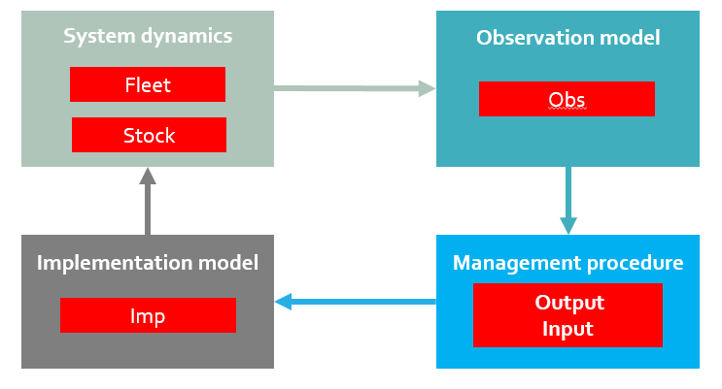
Four of these items are the objects we used to build an operating model
Fleet, Stock, Obs and Imp Objects all contain ‘slots’ that
define the various aspects of the operating model .
These objects and their slots are all ‘glued’ together in an operating model, allowing for customizability.
You can see what these look like by typing the name of one into
R…

Slide 5
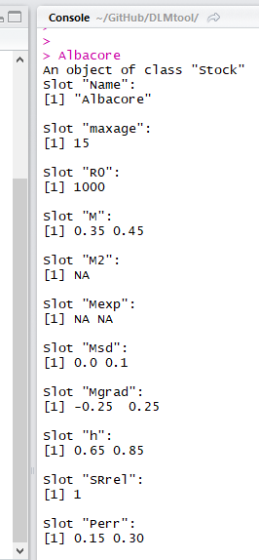
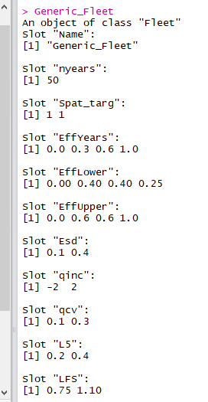
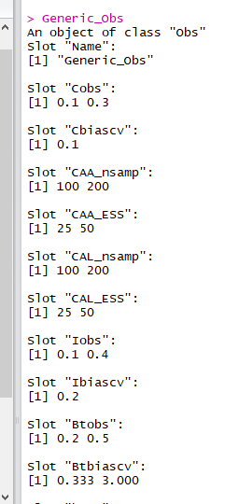
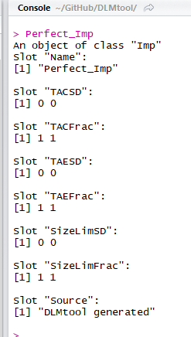
Here is what these objects look like in R:
Stock object
Fleet object
Obs object
Imp object

Slide 6
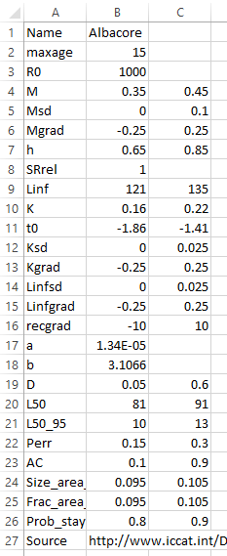
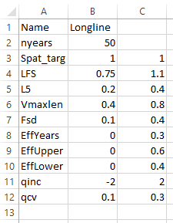
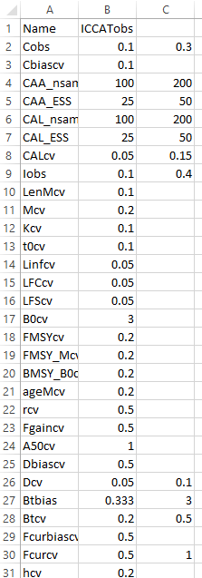
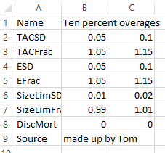
Alternatively each object can be specified in a CSV file:
Stock object
Fleet object
Obs object
Imp object

Slide 7
CSV files can be handy and are easy to import into DLMtool:
Albacore = new(‘Stock’, ’C:/mydata/Albacore.csv’)
Longline = new(‘Fleet’, ‘C:/mydata/Longline.csv’)
ICCATobs = new(‘Obs’, ‘C:/mydata/ICCATobs.csv’)
Overages = new(‘Imp’, ‘C:/mydata/Overages.csv’)
myOM = new(‘OM’, Albacore,
Longline,
ICCATobs,
Overages)
Once imported these objects can be combined in an Operating model:

Slide 8
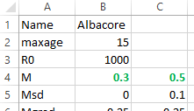
Changing inputs is simple in the CSV:
It is also straightforward in R:
Albacore@M = c(0.3, 0.5)

Slide 9
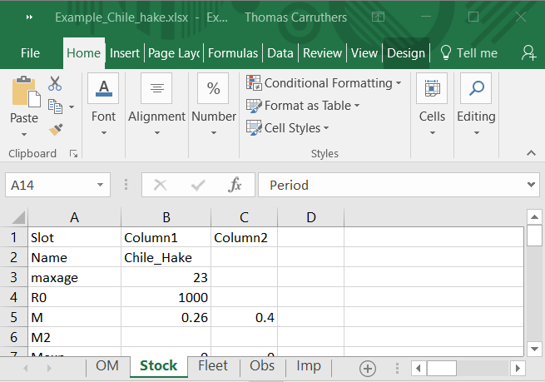
hake = XL2OM(‘Example_Chile_hake.xlsx’)

Slide 10
Getting help with objects
Cheat sheets for objects: /Help/Cheat sheets/
User manual: /Help/DLMtool 5 User Guide.pdf
DLMtool manuscript /Help/DLMtool Manuscript.docx
R package help: class?Stock
class?Fleet
class?Obs
class?Imp
class?OM
Online help: https://dlmtool.github.io/DLMtool/index.html

Slide 11
Handy commands
slotNames() slotNames(Albacore)
slotNames(‘Stock’)
slotNames(‘Imp’)
XL2OM() XL2OM(‘C:/example OM.xlsx’)

